Slide 1
Engineering
Octavio Ortiz
Engineering & Computer Science
February 2nd, 2025

Slide 2
Pre-Engineering A.S. - IVC
For students seeking degree in:
Aerospace Engineering
Civil Engineering
Computer Engineering
Electrical Engineering
Mechanical Engineering
Structural Engineering

Slide 3
Electrical Circuits & Programming

Slide 4
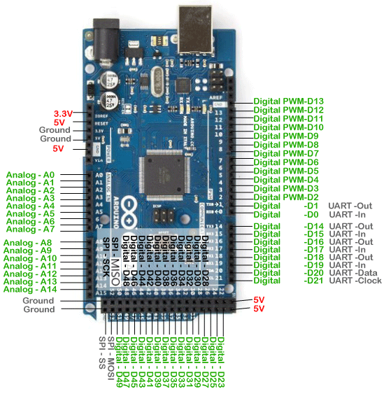
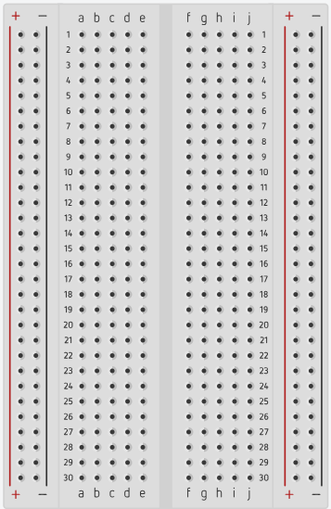
Arduino Mega 2560
Breadboard
Can be ON/OFF
Can range 0-255

Slide 5
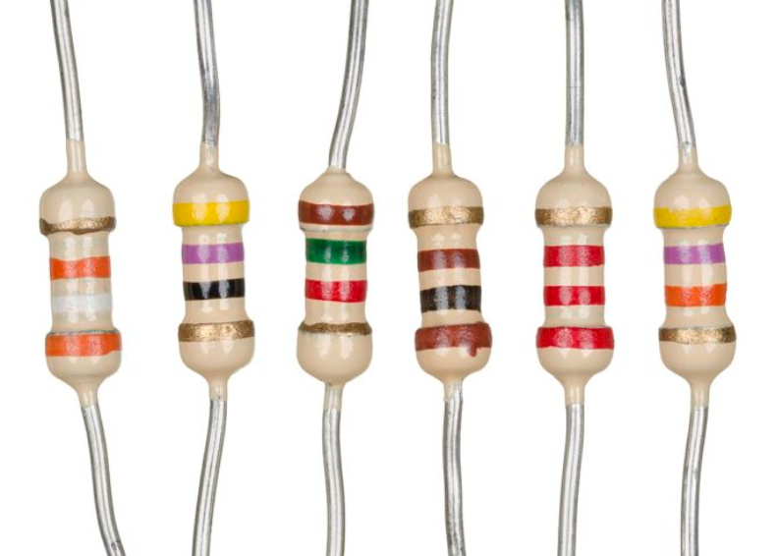
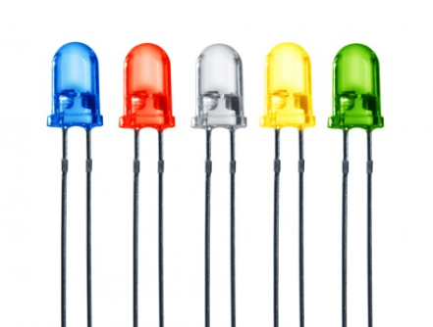
Resistors
Breadboard

Slide 6
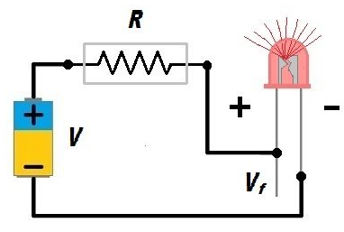
Electric Circuit
330 Ω
5V
Arduino
Cathode
Negative Terminal
Short leg
Anode
Positive Terminal
Long leg
Ground0V

Slide 7
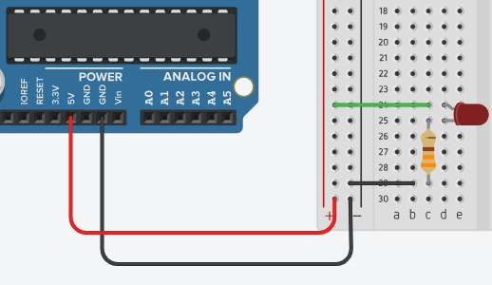
LED ON – Constant Power (no coding)
5V Pin
Always ON
+5 Volts
GND Pin
Always OFF
0 Volts

Slide 8
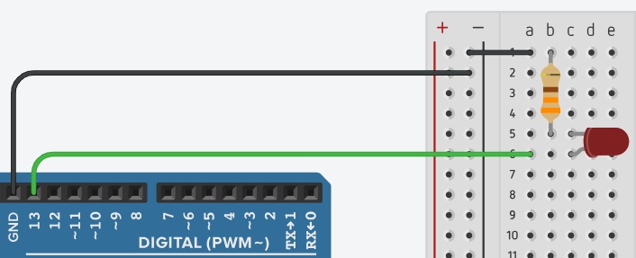
LED ON/OFF – Circuit

Slide 9
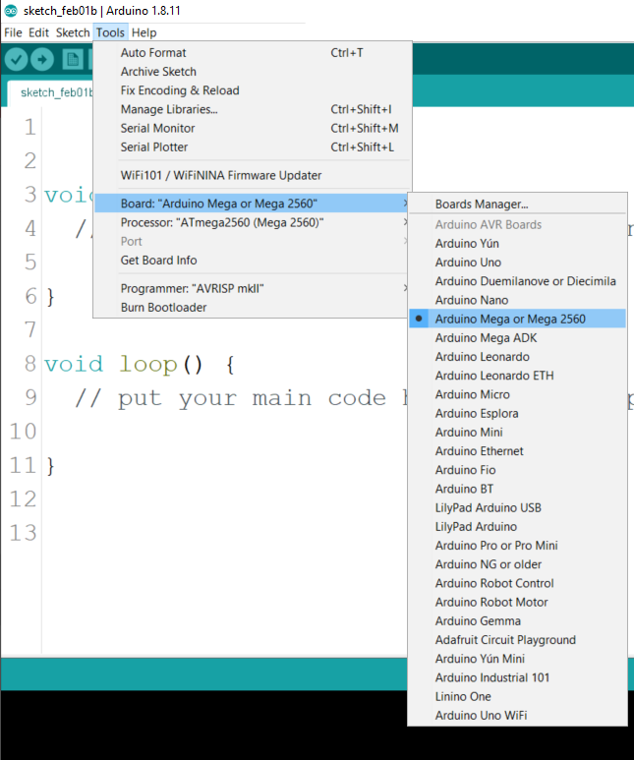

Arduino IDE

Slide 10
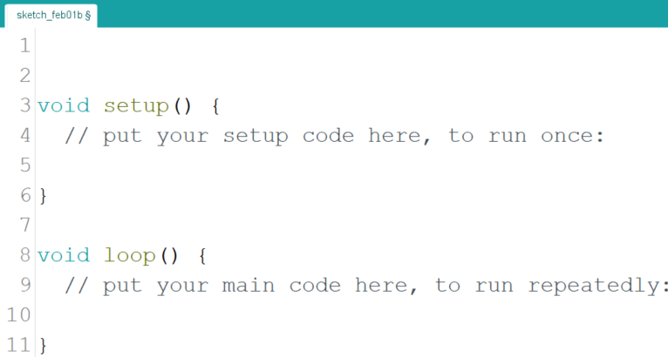
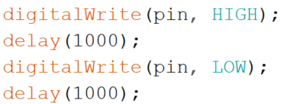

LED ON/OFF – Code
Verify & Upload

Slide 11
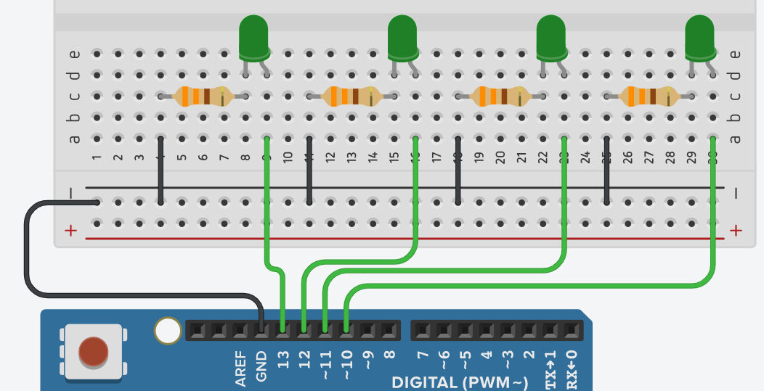
LEDs

Slide 12
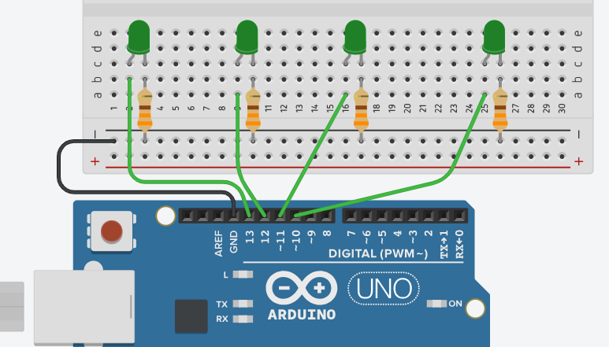
LEDs (Alternative hookup)

Slide 13
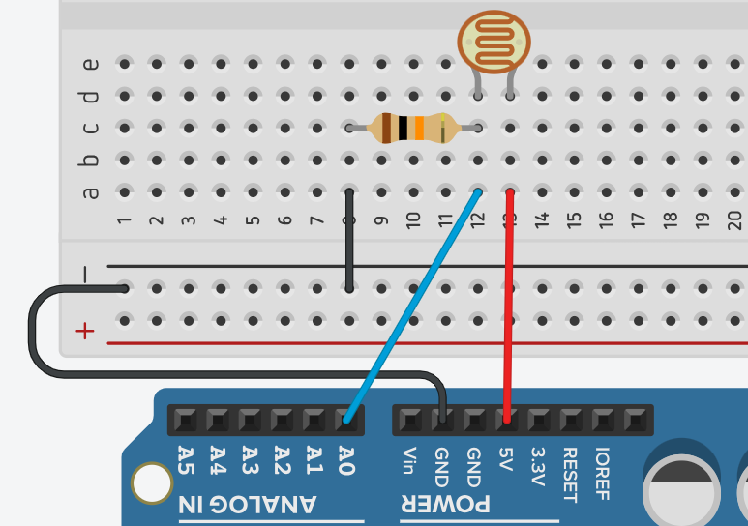
Photoresistor

Slide 14
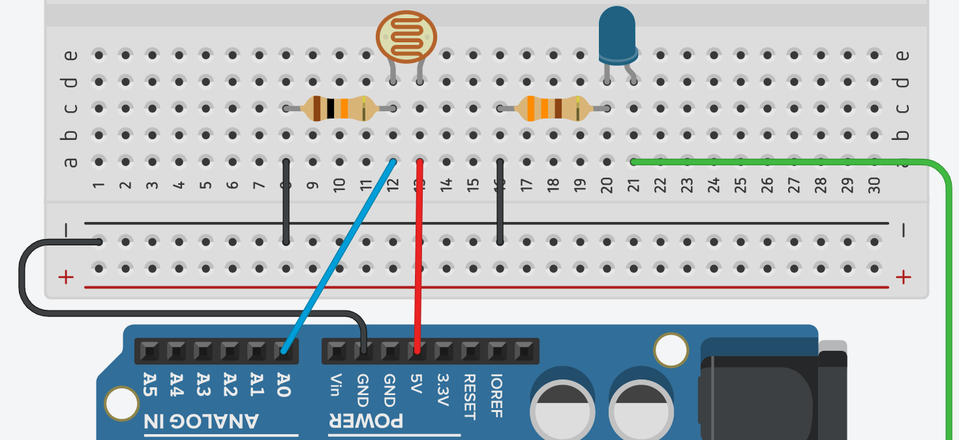
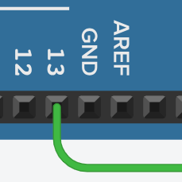
Sensor

